Slide 1

PROJECT MANAGEMENT PLAN
AI-Driven Soil Moisture
Forecasting for Australian
Agriculture
A Project Management Plan for benchmarking zero-shot foundation models against fine-tuned deep-learning baselines on Murray-Darling Basin soil-moisture data.
DeepMoisture
Sensing tomorrow's soil, today.
ITEC630 • IT Masters Project Part A • Semester 1, 2026
TEAM SANSS
Sudip Paudyal · Amir Tamang · Nischal Rai · Syarifah Haninah · Suhana Pradhan
Submitted to: Walayat Hussain
Australian Catholic University

Slide 2










Agenda
What we'll walk you through over the next 15 minutes
01
Project Overview
06
Team & Resources
Why this project, and why now
5 members, clear roles
02
Technical Requirements
07
Risk & Quality
Functional & non-functional specs
What could go wrong, and our plan
03
Methodology
08
Communication & Cost
Hybrid Agile + CRISP-DM
Stakeholders, channels, budget
04
Scope & WBS
09
MVP Demonstration
What's in, what's out
Why we built a working prototype
05
Schedule & Sprints
10
Key Takeaways
7 sprints, 14 weeks
What we want you to remember
DeepMoisture • ITEC630 • Team SANSS
2 / 18

Slide 3





Project Overview
Why is forecasting soil moisture in the Murray-Darling Basin worth solving?
40%
1M km²
23%
of Australia's farm output
Murray-Darling Basin
farm profit drop in drought
The Problem
Our Solution: DeepMoisture
Traditional ARIMA and statistical models struggle to capture the non-linear extremes of Australian climate — and that's where farmers need them most.
Deep learning (LSTM) works, but it demands huge local datasets and weeks of fine-tuning. That's a real barrier for academic and farm-level deployment.
And foundation models? They've been hyped on academic benchmarks since 2024 — but no one has rigorously tested them on Murray-Darling soil moisture under real Australian climate extremes.
That's the gap we close.
A head-to-head benchmark — managed under a hybrid Agile+CRISP-DM framework — answering one clean research question:
Can zero-shot foundation models match (or beat) fine-tuned baselines on real Australian agricultural data?
• Zero-shot Chronos-2 + TimesFM 2.5 — no local training needed.
• Tuned ARIMA, XGBoost, LSTM baselines for honest comparison.
• A Streamlit dashboard delivering forecasts + uncertainty bands to farmers.
DeepMoisture • ITEC630 • Team SANSS
3 / 18

Slide 4




Technical Requirements — System Architecture
A four-layer pipeline: data in, forecasts out
Course scope reminder: ITEC630 is graded on the project-management plan itself — but Team SANSS also built a working MVP to prove every requirement is genuinely buildable within constraints.
LAYER 01
LAYER 02
LAYER 03
LAYER 04
Data Ingestion
Processing
Model Layer
Presentation
SILO • TERN • BoM APIs
pandas • NumPy • DVC
Chronos-2 • TimesFM • PyTorch
Streamlit • Plotly
Pulls climate, soil-moisture, and streamflow data via REST and OGC web services.
Temporal alignment, gap-filling, feature engineering, versioned train/val/test splits.
Runs zero-shot and fine-tuned foundation models against ARIMA, XGBoost and LSTM baselines.
Interactive dashboard with station selection, forecast charts, and uncertainty bands.
Modular by design — each layer can be swapped, tested, or upgraded independently. That's how we keep risk low.
DeepMoisture • ITEC630 • Team SANSS
4 / 18

Slide 5

Functional Requirements — What the System Must Do
13 requirements, prioritised using MoSCoW — here are the eight that drive our build
ID
Requirement
Description
Priority
FR-01
Automated Data Ingestion (SILO)
Pull daily rainfall, temperature, ET, humidity from SILO REST API for 10+ MDB stations.
MUST
FR-02
Soil-Moisture Target (TERN SMIPS)
Download daily volumetric soil moisture from TERN at 1 km grid resolution.
MUST
FR-05
Preprocessing Pipeline
Align all sources to daily resolution, perform QC, fill gaps <3 days via linear interpolation.
MUST
FR-07
Baseline Models
Implement persistence, climatology, ARIMA, XGBoost, and LSTM as comparison baselines.
MUST
FR-08
Foundation Models — Zero-Shot
Run Chronos-2 and TimesFM 2.5 with no local training; produce probabilistic forecasts.
MUST
FR-09
Foundation Models — Fine-Tuned
Fine-tune both models on Australian data with weather covariates.
MUST
FR-11
Evaluation Framework
Compute KGE, RMSE, MAE, NSE, R², PBIAS, CRPS at all horizons; Diebold-Mariano tests at p < 0.05.
MUST
FR-12
Streamlit Dashboard
Station-selection map, time-series plots with uncertainty bands, model comparison, CSV export.
MUST
Every requirement above has measurable acceptance criteria — no requirement is 'done' until its test passes. Full MoSCoW set (FR-01 → FR-13) in the project plan document.
DeepMoisture • ITEC630 • Team SANSS
5 / 18

Slide 6




Non-Functional Requirements — How the System Must Behave
Quality attributes turn a working system into a trustworthy one
NFR-01
NFR-02
NFR-03
NFR-04
Performance
Scalability
Reproducibility
Reliability
Inference for all stations within 5 minutes on single GPU.
Add stations via YAML — zero code changes required.
100% reproducible runs via DVC + fixed random seeds.
API retry logic with exponential backoff; zero silent failures.
NFR-05
NFR-06
NFR-07
NFR-08
Usability
Security
Portability
Maintainability
<1% task failure rate for new users in peer beta testing.
API keys in environment variables; zero credentials in Git history.
Single conda env runs on Linux, macOS, and Windows.
PEP-8 compliant; ≥60% test coverage; Google-style docstrings.
Why does this matter? Because evaluators — and ultimately the farmers we want to help — only trust forecasts they can run, repeat, and verify for themselves.
DeepMoisture • ITEC630 • Team SANSS
6 / 18

Slide 7




Data Sources & Technology Stack
Open, government-grade data — paired with state-of-the-art open-source tools
AUSTRALIAN GOVERNMENT DATA SOURCES
OPEN-SOURCE TECHNOLOGY STACK
SILO Climate
Modelling
Queensland Government
Chronos-2 (Amazon) • TimesFM 2.5 (Google) • PyTorch • XGBoost
Rainfall, temperature, ET, humidity — daily, ~5 km grid since 1889.
TERN SMIPS
Data
Terrestrial Ecosystem Research Network
Python 3.11 • pandas / NumPy • DVC for data versioning
Daily volumetric soil moisture at three depth layers, 1 km grid.
TERN CosmOz
Frontend
Cosmic-ray neutron sensors
Streamlit • Plotly • Streamlit Cloud (free tier)
Ground-truth soil moisture at 16+ Australian sites for validation.
BoM Water Online
Ops
Bureau of Meteorology
Jira (Scrum board) • GitHub + Actions CI/CD • Google Colab Pro (GPU)
Streamflow & storage from ~3,500 hydrological stations.
DeepMoisture • ITEC630 • Team SANSS
7 / 18

Slide 8

Methodology — Hybrid Agile + CRISP-DM
Why one framework wasn't enough
Pure Agile struggles with the experimental nature of ML modelling. Pure CRISP-DM lacks Agile's discipline. We embed CRISP-DM phases inside Agile sprints — getting iteration speed AND scientific rigour.
AGILE SCRUM
CRISP-DM LIFECYCLE
Project execution layer
Data-science scientific layer
7 sprints × 2 weeks (14-week semester total)
Tracked in Jira with capability-based backlog
Daily async stand-ups via Slack
Bi-weekly Sprint Reviews with our Supervisor
Sprint Retrospectives — continuous improvement
Story-point velocity to forecast workload
Business Understanding — research question framing
Data Understanding — SILO/TERN exploratory analysis
Data Preparation — QC, gap-filling, feature engineering
Modelling — baselines, then foundation models
Evaluation — KGE, RMSE, statistical significance tests
Deployment — Streamlit dashboard for end-users
= Each CRISP-DM phase becomes a trackable, time-boxed Jira deliverable.
DeepMoisture • ITEC630 • Team SANSS
8 / 18

Slide 9

Scope & Work Breakdown Structure
Five phases, clear boundaries — so nothing slips through the cracks
DeepMoisture
1.0
2.0
3.0
4.0
5.0
Initiation & Data
Baseline Models
Foundation Models
Integration
Closure
1.1 SILO/TERN API setup
1.2 EDA & data QC
1.3 Feature engineering
1.4 DVC versioning
2.1 ARIMA training
2.2 XGBoost training
2.3 LSTM training
2.4 KGE/RMSE benchmark
3.1 Chronos-2 zero-shot
3.2 TimesFM zero-shot
3.3 Fine-tuning loop
3.4 GPU optimisation
4.1 Streamlit wireframes
4.2 Forecast charts
4.3 Station selector
4.4 Uncertainty bands
5.1 Beta testing
5.2 Final report
5.3 Sponsor sign-off
5.4 Code archival
OUT OF SCOPE: physical IoT hardware • real-time edge computing • commercial web hosting • satellite imagery purchase
DeepMoisture • ITEC630 • Team SANSS
9 / 18

Slide 10
Schedule — 7 Sprints, 14 Weeks
Time is our least flexible constraint — so every sprint has a clear deliverable
Sprint
Weeks
Phase
Key Deliverables
Timeline (W1 → W14)
S1
W1–2
Initiation
PMP finalised, Jira board live, GitHub repo, Colab environments ready
S2
W3–4
Data Engineering
SILO/TERN extraction scripts, EDA notebook, missing-data handling
S3
W5–6
Baselines
ARIMA + LSTM trained; first KGE/RMSE benchmark numbers in W&B
S4
W7–8
Zero-Shot FM
Chronos-2 + TimesFM running zero-shot on MDB stations
S5
W9–10
Fine-Tuning
Fine-tuned weights converged; GPU memory monitored & optimised
S6
W11–12
Dashboard
Streamlit UI wireframes → interactive charts → uncertainty bands
S7
W13–14
Closure
Beta testing (<1% failure target), final report, presentation
Key Milestones: M1 PMP signed off (W2) • M2 Data pipeline live (W4) • M3 Baselines benchmarked (W6) • M4 FM fine-tuned (W10) • M5 Dashboard MVP (W12) • M6 Final delivery (W14)
DeepMoisture • ITEC630 • Team SANSS
10 / 18

Slide 11





Team SANSS — Five Members, Five Specialisations
Roles built around the project's natural fault lines: PM, data, modelling, frontend, comms
Amir Tamang
Nischal Rai
Suhana Pradhan
Syarifah Haninah
Sudip Paudyal
S00393664
S00392579
S00393735
S00394184
S00391778
Project Manager
Data Engineer
Software Developer
Quality & Scope Lead
Communications Lead
Oversees execution, manages coordination, keeps us on scope and on schedule.
Owns SILO/TERN data pipelines, exploratory analysis, and core methodology.
Leads system implementation and the interactive Streamlit dashboard.
Manages scope boundaries, identifies risks, enforces quality baselines.
Internal comms, sprint progress tracking, stakeholder reporting.
Peak:
Peak:
Peak:
Peak:
Peak:
Sprints 1 & 6
Sprints 2 & 3
Sprints 5 & 6
Sprints 4 & 6
Continuous (W1-12)
Standard availability: 10–12 hrs/week each, with role-specific peaks aligned to Agile sprint rhythm.
DeepMoisture • ITEC630 • Team SANSS
11 / 18

Slide 12


Risk Management — Identify Early, Mitigate Decisively
Four risks we're actively watching, with concrete fall-back plans
R-01 TECHNICAL
MITIGATION
GPU memory limits on Colab
Aggressively monitor consumption. If approached: reduce batch sizes, use gradient accumulation, or fall back to zero-shot inference only.
PROB
High
IMPACT
High
R-02 TECHNICAL
MITIGATION
Data pipeline / API downtime
Robust error-handling with exponential backoff in extraction scripts; forward-fill and interpolation for missing sensor values.
PROB
Medium
IMPACT
Medium
R-03 PROJECT
MITIGATION
Foundation models underperform baselines
Pivot the report to analyse WHY traditional models won in this context — academically valid either way. Hybrid ensemble as plan B.
PROB
Medium
IMPACT
Medium
R-04 PROJECT
MITIGATION
Schedule slippage on dashboard
MVP-first approach: core forecasting charts ship in Sprint 6; advanced filtering moves to backlog if time runs short.
PROB
Low
IMPACT
Medium
DeepMoisture • ITEC630 • Team SANSS
12 / 18

Slide 13



Quality Management — How We Prove It Works
Quality isn't a checkbox — it's the metrics we hit and the tests we pass
Model Accuracy
System Quality
Dashboard UX
KGE (Kling-Gupta Efficiency)
Code style
Task failure rate
→ Foundation > ARIMA baseline
→ PEP-8 compliant, flake8 clean
→ <1% in peer beta testing
RMSE (Root Mean Square Error)
Test coverage
Load time
→ Foundation < ARIMA RMSE
→ ≥60% on core modules
→ Dashboard renders in <5 seconds
CRPS (probabilistic skill)
Reproducibility
Interactive elements
→ Calibrated uncertainty bands
→ 100% reproducible via DVC
→ Station map, charts, CSV export
Diebold-Mariano test
Documentation
Accessibility
→ Statistical significance @ p < 0.05
→ Google-style docstrings everywhere
→ Clear labels, minimal jargon
TESTING STRATEGY: Temporal data splitting (no leakage) • Comparative model benchmarking • Beta usability testing • W&B experiment tracking
DeepMoisture • ITEC630 • Team SANSS
13 / 18

Slide 14


Communication & Stakeholders
Right channel, right cadence, right audience — every time
COMMUNICATION CHANNELS
STAKEHOLDER ENGAGEMENT MAP
Daily Stand-up (Slack)
HIGH INFLUENCE →
Daily, async • Team (×5)
ACU Coordinator
Supervisor
Sprint Review
Keep Informed
Manage Closely
Bi-weekly (EOD) • Team + Supervisor
Project Team
Milestone Report
Lead/Collaborate
W5, W9, W13 • Supervisor + Coordinator
Jira Board
Continuous • Team
Sprint Retrospective
MDB Farmers (end users)
Bi-weekly • Core team
Monitor
LOW INFLUENCE
DeepMoisture • ITEC630 • Team SANSS
14 / 18

Slide 15
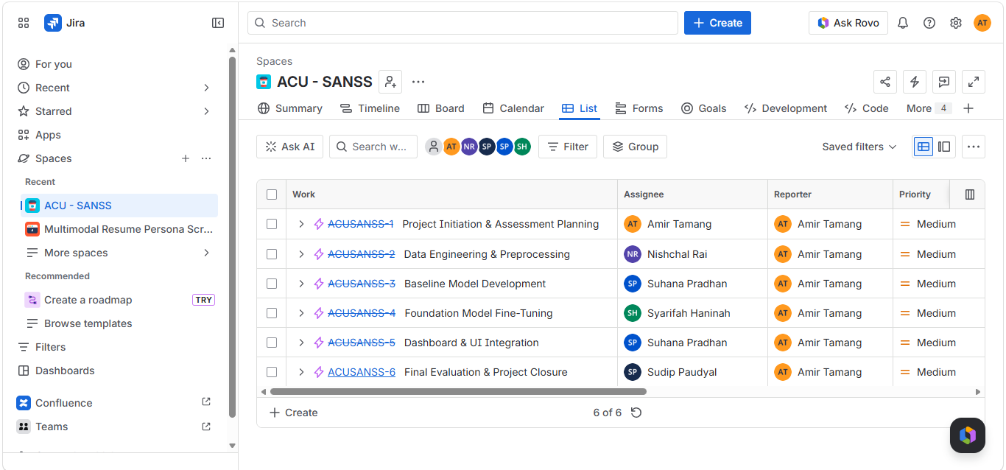
Jira Dashboard
DeepMoisture • ITEC630 • Team SANSS
14 / 18

Slide 16



Cost & Procurement
An academic project — minimal real spend, with a simulated PM exercise for comparison
ACTUAL CASH OUTLAY
Google Colab Pro subscription (≈$12/month × 3 months).
Everything else is open-source or free academic-tier access.
≈ $36 AUD
OPEN-SOURCE FIRST PROCUREMENT
SIMULATED COMMERCIAL BUDGET
SILO & TERN API access
(PMBOK cost-management exercise — not real spend)
Free · CC BY 4.0 · Required: Before Sprint 2
Google Colab Pro (GPU)
≈$12 AUD/month · Required: Before Sprint 4
GitHub + DVC storage
Free · education plan · Required: Before Sprint 1
Chronos-2 / TimesFM weights
Free · Apache 2.0 · Required: Before Sprint 4
Note: The $17,700 figure represents simulated labour-hour costs at notional industry rates — a PMBOK-style cost-baseline exercise from Assessment 1, not an actual invoice.
DeepMoisture • ITEC630 • Team SANSS
15 / 18

Slide 17


Why We Also Built an MVP
ITEC630 grades the plan — but we wanted proof the plan is buildable
Why bother with an MVP when this course is about project management? Because a plan you can't execute is just a wish-list. Building an MVP lets us de-risk every technical assumption in the PMP.
Validates Risk Estimates
Confirms Feasibility
Strengthens Stakeholder Trust
If GPU memory blows up in MVP testing, we know exactly where to harden Sprint 5 — before it becomes a real-deadline crisis.
Running Chronos-2 zero-shot on a single MDB station proves the foundation-model approach works on our actual data, not just paper benchmarks.
A live demo, however rough, is more persuasive than 30 pages of plans. Supervisors see we'll deliver — and so do we.
MVP SCOPE — what's already built
✓ SILO data extraction script (single station) ✓ ARIMA baseline trained ✓ Chronos-2 zero-shot output
✓ Streamlit dashboard skeleton ✓ GitHub repo + Jira board live ✓ KGE/RMSE evaluation script
DeepMoisture • ITEC630 • Team SANSS
16 / 18

Slide 18
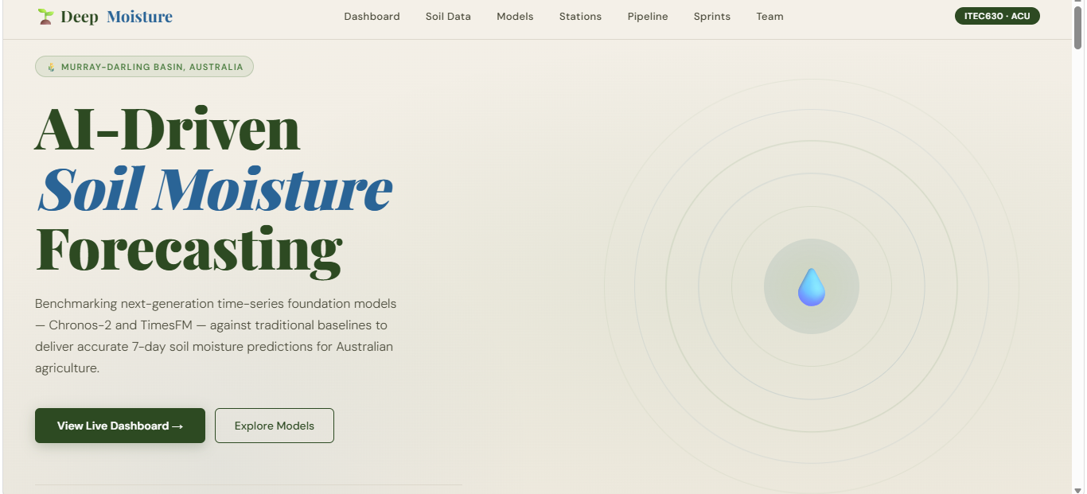
Why We Also Built an MVP
data extraction script (script
DeepMoisture • ITEC630 • Team SANSS
16 / 18

Slide 19
Key Takeaways
If you remember five things, remember these
01
Genuine novelty
First rigorous benchmark of Chronos-2 and TimesFM 2.5 on Murray-Darling Basin soil-moisture data.
02
Hybrid methodology
Agile sprints provide rhythm; CRISP-DM phases provide scientific rigour. Best of both worlds.
03
Proactive risk plan
GPU limits, API downtime, model underperformance — each has a concrete mitigation already in place.
04
Five-person team, clear roles
PM, Data, Software, Quality, Comms — no overlap, no gaps, every sprint owned.
05
Ethical alignment
ACS Code of Ethics + environmental stewardship: optimise water use for farmers, not commercial extraction.
Every drop counts. AI helps us count them.
DeepMoisture • ITEC630 • Team SANSS
17 / 18

Slide 20
WE'D APPRECIATE YOUR INPUT ON:
Scope realism
Is our scope ambitious yet achievable in 14 weeks?
Risk coverage
Are there technical risks we're missing for foundation models?
THANK YOU
Questions?
Stakeholder reach
Should we engage MDB farmers earlier in user testing?
We'd love your feedback.
Evaluation metrics
Are KGE/RMSE the right yardsticks — or should we add CRPS?
Team SANSS • ITEC630 • Australian Catholic University • Semester 1 2026

